Slide 1
Overview of Survey Management

Slide 2
About the Author
Created By: | Ankita Kumari
Credential Information: | Associate – CRM, EAS Salesforce
Version and Date: | V1, 22-Jan-2018, V2.0: July-2023:Updated with Lightning UI
Modified By: | Ritesh Kumar Prasad & Srijena,N

Slide 3

Objectives
After completing this chapter, you will learn to:
  Describe and Create survey life cycle
  Describe Survey Management Page
  Describe Data Model

Slide 4
Recap ...
In the previous Module - Coaching Report, you learnt to:
  Configure & Share a Coaching Report
  Describe User access for Reports
  Create Coaching report
And now ...

Slide 5

Overview
The Survey module is designed specifically for business users to be able to create a Survey, add questions, define weights and segments, define target lists, and publish the Survey to end users online and offline, all without assistance from the IT department
There is a lookup relationship to associate the Survey Question record and the corresponding record in the Question Bank
Changes made on one copy of the question do not affect copies residing elsewhere
The Survey Management page includes a UI for targeting accounts for a particular Survey. From this UI, a Target list is built for a Survey before it is available to users
New Targets can also be added after a Survey is published

Slide 6

Do You Know
We can place marker fields on the page layout and include those details in your application like zvod_Questions_vod, zvod_Segments etc. and the marker field never stores data
Adding survey questions limit is 25 from frontend. However, there is no limit of survey question loaded from data loader
Only 10 picklist values are allowed from front end. However, there is no limit of picklist value loaded from data loader
We can configure outstanding survey on call record by providing FLS on
zvod_Survey_Target_vod marker field and putting this field in the new section
on call layout

Slide 7
Introduction to Surveys

Slide 8
Surveys Overview ... 1
Surveys are groups of questions that users/reps answer about their accounts
Surveys are created to help users/rep better understand their accounts by building a profile of the account
It also helps to gather information for market research to help brand messaging and to allocate sales resources

Slide 9
Surveys Overview ... 2
A Survey may be a
  One Time Survey
    Survey can be submitted by a user once on single account
  Recurring Survey
    Users can capture new responses from an account, using the previous responses as a base
Type Of Survey
One Time
Recurring

Slide 10
VEEVA Survey Life Cycle

Slide 11
VEEVA Survey Life Cycle ... 1
Creating a Survey
Publishing a Survey
Retiring a Survey
End User Survey
Execution
Monitoring
Survey Results
Creating a Survey
Surveys are created via the Survey tab online
When a user creates a Survey, basic parameters are defined
  Select if Survey is one-time or recurring
  Survey Name, Start Date, and End date are all required
  Select the channels for Survey deployment
  Define Assignment Rules – how the survey is assigned to end users
    Territory only – System assigns a user based on territory
    Product & Territory – System assigns a user based on territory and product

Slide 12
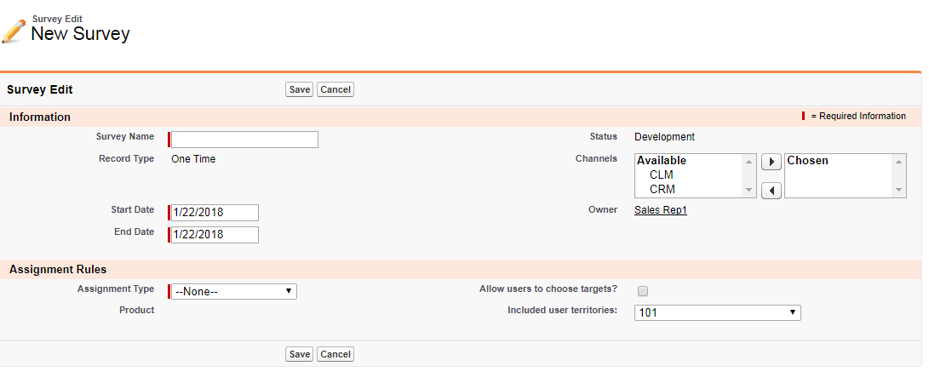
VEEVA Survey Life Cycle ... 2
Creation of a New Survey

Slide 13
VEEVA Survey Life Cycle ... 3
Adding Survey Questions
New questions are created directly on a Survey questions can also be added from a Question Bank.
Adding Segments
Segments are ways to group accounts based on their Survey responses.
Adding
Survey
Targets
Survey Targets are linking records between an account and a Survey.
Questions created on Surveys can be pushed into the Question Bank to be reused on other Surveys in the future.
There is a lookup relationship to associate the Survey Question record and the corresponding record in the Question Bank. Changes made on one copy of the question do not affect copies residing elsewhere.
Each segment contains a name, a minimum score, and a maximum score. Scores are calculated on the Survey Target object by summing the individual scores of each Question Response.
Segments cannot overlap with each other and cannot exceed the minimum and maximum score values of the Survey.
When a Survey Target is added to a Survey, a new record is created.
Each instance of the account responding to the Survey is a unique Survey Target record. Therefore, if there is a recurring Survey a user completes every three months for an account, four Survey Target records are created in a year.

Slide 14
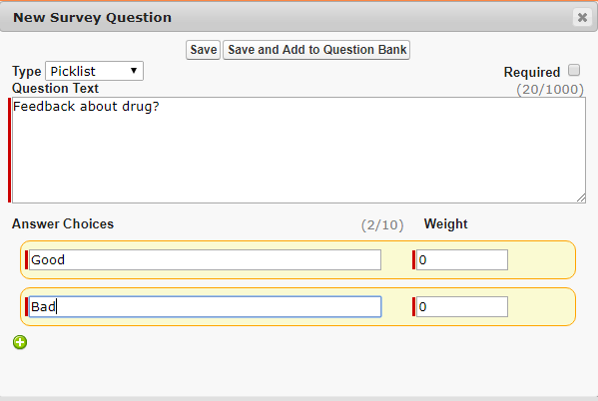
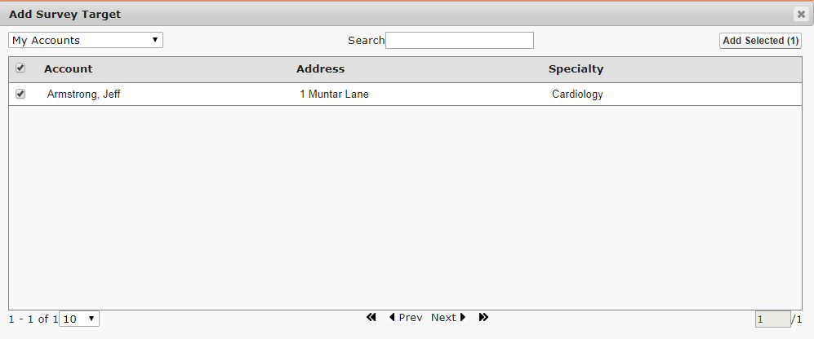
VEEVA Survey Life Cycle ... 4
Adding Survey Questions
Adding Survey Targets

Slide 15
VEEVA Survey Life Cycle ... 5
Publishing a Survey
Publishing is the process of pushing a Survey out to the field to be completed by end users
Publishing locks the Survey so edits to Survey properties and questions is no longer possible
During publish, Survey Target records are assigned to users based on Assignment Rules
End User Survey Execution
End users execute a survey for an account, they are completing and submitting a Survey Target record

Slide 16
VEEVA Survey Life Cycle ... 6
Monitoring Survey Results
After survey submission Pick-list, radio, and multi-select questions display tables showing the percentage of responses for each answer choice
Other question types display a count of the number of responses collected
Retiring a Survey
Once a Survey has passed its end date, an expired flag is set on the Survey record
Survey Target records cannot be answered by end users after the end date has passed

Slide 17
Survey Management

Slide 18
Survey Management ... 1
The Survey Management Page is the place which helps editing the contents of an individual Survey, as well as viewing results after a Survey is published
Survey Management Page Sections
Survey header information
Questions section
Segments section
Targets section

Slide 19
Survey Management ... 2
The Question, Segments, and Targets sections are rendered on the page layout based on the presence of zvod marker fields
These individual fields can be added or removed from the page to determine which sections are available to the user
zvod_Questions_vod
Display the Questions section. Remove if you do not want the user to be able to view, create, or edit questions on the Survey
zvod_Segments_vod
Displays the Segments section. Remove if you do not want the user to view, create, or edit segments on the Survey
zvod_Targets_vod
Displays the Targets section. Remove if you do not want the user to add or remove Survey Targets

Slide 20
Survey Management ... 3
Survey Status = Development
Edit button displays if the user has edit permission to Survey_vod
Publish button displays if the user has edit permission to Survey_vod and Survey_Target_vod
Clone button displays if the user has create permission Survey_vod and Survey_Question_vod
Delete button displays if the user has delete permission on Survey_vod
Translate button displays if the user has create privilege on Survey_vod and Survey_Question_vod

Slide 21
Survey Management ... 4
Survey Status = Published or Completed
Clone button displays if the user has create permission on Survey_vod
Unlock displays if the user has edit permission to the Lock_vod field
Translate button displays if the user has create privilege on Survey_vod and Survey_Question_vod
Publish to New Targets button displays if the user has edit permission to Survey_Target_vod andSurvey_vod and has added new targets

Slide 22
Survey Management ... 5
Displaying Survey Score
Surveys can be used to evaluate pharmacies according to various criteria
for example, meeting certain product placement parameters in a pharmacy, to identify next steps for maximizing the selling potential of the product
Configuration
Grant admin users FLS edit permission to the following fields:
  Score_Display_vod field on the Survey_vod object
  Max_Score_vod field on the Survey_Question_vod object
  Score_vod field on the Question_Response_vod object
  Max_Score_vod field on the Question_Response_vod object
Place the Score_Display_vod field on the appropriate Survey_vod page layouts

Slide 23
Survey Management ... 6
To enable end users to view the survey score:
Grant FLS read permission to the following fields:
  Score_Display_vod field on the Survey_vod object
  Max_Score_vod field on the Survey_Question_vod object
Grant FLS edit permission to the following fields:
  Score_vod field on the Question_Response_vod object
  Max_Score_vod field on the Question_Response_vod object

Slide 24
Survey Data model

Slide 25
Survey Data Model
The Surveys module consists of five objects
Survey Objects
Survey_vod
Survey_Question_vod
Survey_Target_vod
Question_Response_vod
Question_vod

Slide 26
Survey Data Model Flow Chart
Master Details
Survey
Header Information
Survey Target
Survey, Account and Assigned Users
Look Up
Survey
Header Information
Survey Questions
Questions on a survey
Questions Response
Stores Response Data

Slide 27
Check Your Understanding ... 1
1. Which is true in terms of one-time survey?
Statement 1: One-time Survey can be created once on one account by one user
Statement 2: One-time Survey can be created once on one account by multiple user
Statement 1
Statement 2
Statement 1 and 2
Answer: Statement 1
© Cognizant 2015

Slide 28
Check Your Understanding ... 2
2. Users creating and assigning Surveys need to be assigned to a territory in order to use the Territory Assignment Rules.
State True or False
True
False
Answer: True
© Cognizant 2015

Slide 29
Check Your Understanding ... 3
3. What are required fields present in VEEVA while creating a Survey?
Survey Name
Allow user to select target
Start Date and End Date
Assignment Type
Answer: Survey Name, Assignment Type, Start Date and End Date
© Cognizant 2015

Slide 30
Check Your Understanding ... 4
4. Which one from following cannot be a type of question while creating a Survey?
Picklist
Text
Percentage
Radio
Answer: Percentage
© Cognizant 2015

Slide 31
Check Your Understanding ... 5
5. Which permission is required to see clone button if Survey Status = Published or Completed?
Clone button displays if the user has create permission on Survey_vod
Clone button displays if the user has read permission on Survey_vod
Clone button displays if the user has edit permission on Survey_vod
All of the above
Answer: Clone button displays if the user has create permission on Survey_vod
© Cognizant 2015

Slide 32

Summary
  In this module, you have learnt to:
    Describe and Create survey life cycle
    Describe Survey Management Page
    Describe Data Model

Slide 33

Source
https://crmhelp.VEEVA.com/doc/Content/Home.htm
Disclaimer: Parts of the content of this course is based on the materials available from the Web sites and books listed above. The materials that can be accessed from linked sites are not maintained by Cognizant Academy and we are not responsible for the contents thereof. All trademarks, service marks, and trade names in this course are the marks of the respective owner(s).

Slide 34
Coming Next ...
In the upcoming module - Medical Inquiry, you will learn to:
  Describe Medical Inquiries life cycle
  Define the components of Medical Inquiry
  Configure various components of Medical Inquiry module
  Configure Medical Inquiry module for multiple Product inquiries

Slide 35
Thank You !
  You have successfully completed
  Overview of Survey

